Slide 1

REVIEW 3 : CONSUMER SHOPPING ANALYSIS
CLASSIFICATION TECHNIQUES AND FINAL DASHBAORD

Slide 2
CLASSIFICATION METHODS USED
K Means Clustering Algorithm : for clustering variable collections
K-Nearest Neighbors Algorithm : for predicting accuracy of the dataset.

Slide 3
K means clustering algorithm
(implementation)

Slide 4
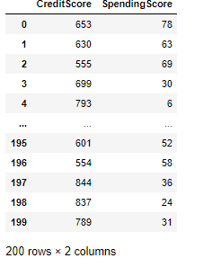
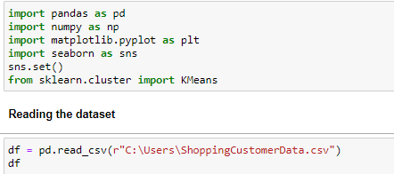
Importing libraries and reading CSV files

Slide 5
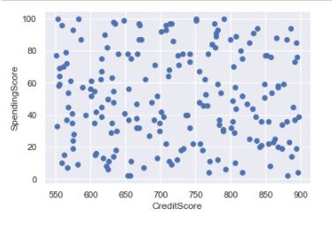
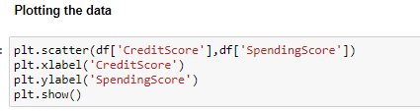
Plotting the obtained dataset

Slide 6
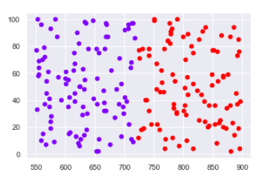

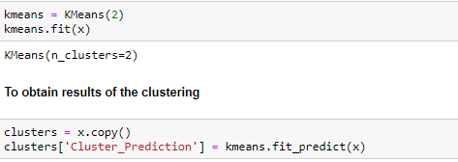
Clustering the dataset
Selecting and copying features into another dataset. We cluster them into 2 groups at first. We then plot the data.
From the above result, it is to be noted that there are two huge groups of unorganized clusters where we can see few clusters within the larger two. Hence this calls for further clustering.

Slide 7
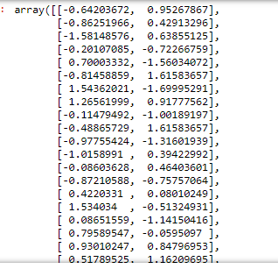

Standardize the variables

Slide 8
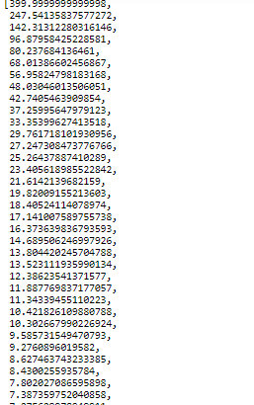
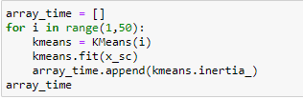
The elbow method

Slide 9
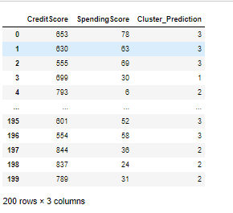

Clustering the new groups

Slide 10
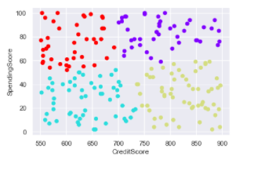
Plotting the final cluster

Slide 11
K-NEAREST NEIGHBORS
(used in this dataset to find accuracy of the dataset)

Slide 12

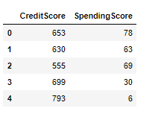



Importing datasets, finding head and shape of datasets.

Slide 13

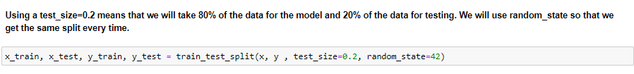
Storing values and testing variables

Slide 14
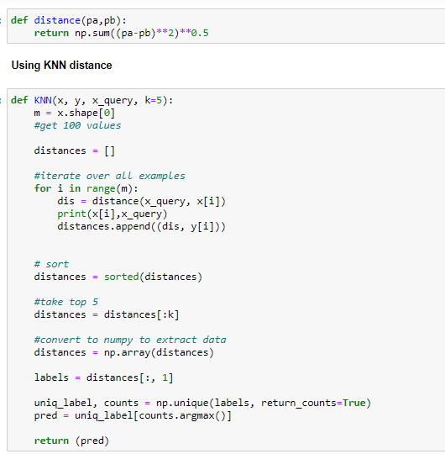
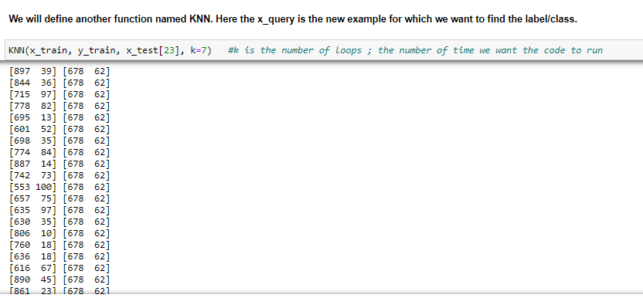
Euclidean and KNN distance

Slide 15
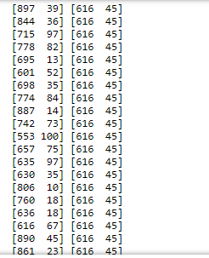

Predicting labels for entire test dataset

Slide 16
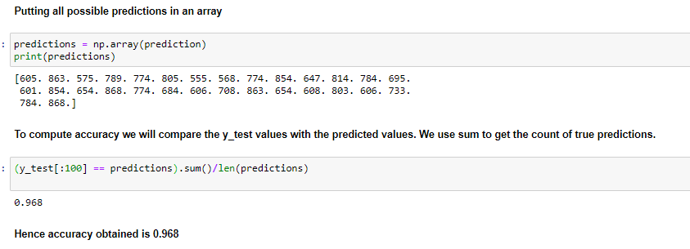
Predictions and Accuracy Predictions

Slide 17
TEAM 7 : GAURAV TRIVEDI (19MIA1077) HARSHINI AIYYER (19MIA1050) ARYA DADHICH (19MIA1025) UDBHAV NEMMANI (19MIA1041)

